Slide 1
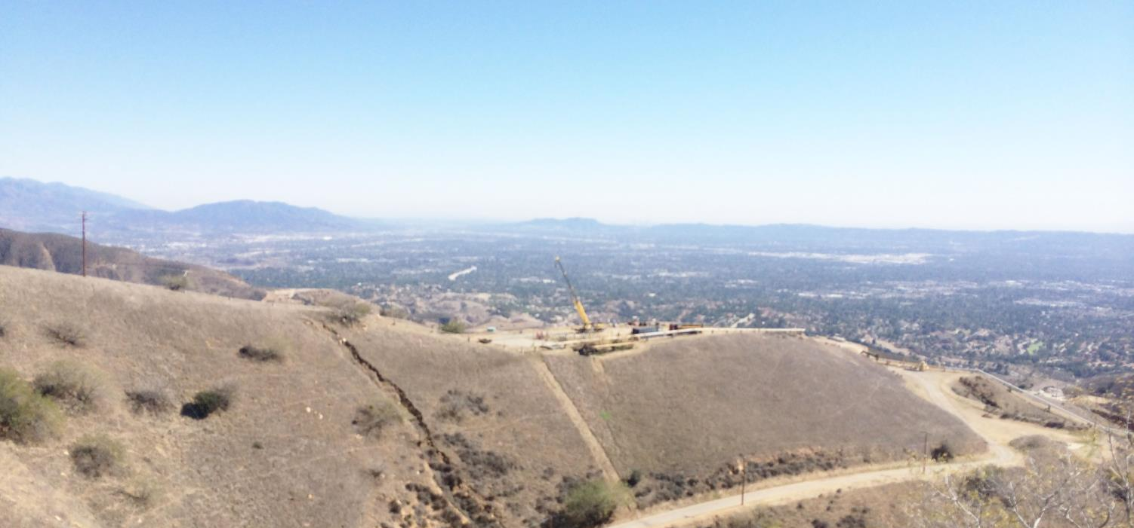
ALISO CANYON
NATURAL GAS STORAGE FACILITY
December 2015

Slide 2
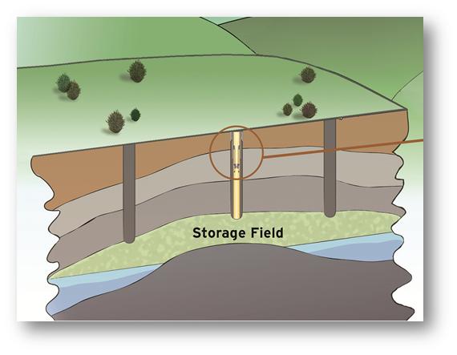
Aliso Canyon Overview
Located in the northern part of the San Fernando Valley in Los Angeles County.
Depleted oil reservoir, by far the most common type of gas storage field in the U.S.
Approximately 3,600 acres of land.
SoCalGas acquired the field in 1972.
Fifth largest capacity in the U.S.
Capacity to store 86 billion cubic feet.

Slide 3
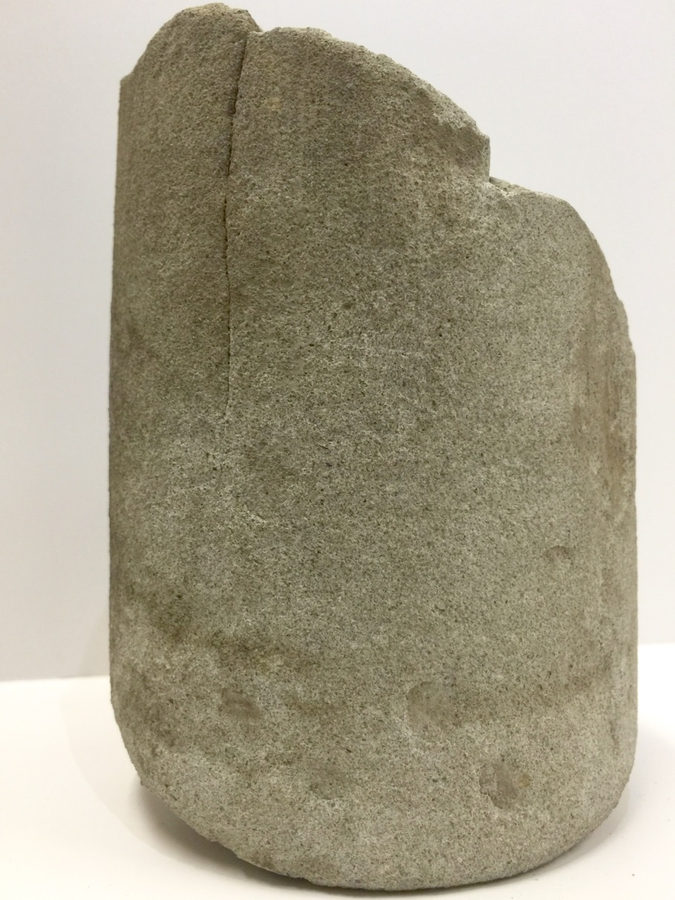
Aliso Canyon
Gas delivered to Aliso Canyon through network of transmission pipelines.
115 wells provide injection and withdrawal capability.
Gas compressed and injected through wells over 8,000 feet underground into protected sandstone formation.
Gas is typically injected in summer.
During times of high demand, gas flowing through pipelines and withdrawn from storage ensure reliability.

Slide 4

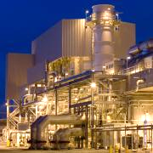

Aliso Canyon is a critical energy facility supporting customer demand and electric grid reliability
Critical element of SoCalGas’ gas delivery system serving over millions of homes and businesses across Southern California.
Gas withdrawn from storage ensures reliability for heating in winter and peak electric generation in summer.
Critical for electric grid reliability, and provides fuel to 14 power plants across southern California.
Supports expanded use of renewable energy resources in California.

Slide 5
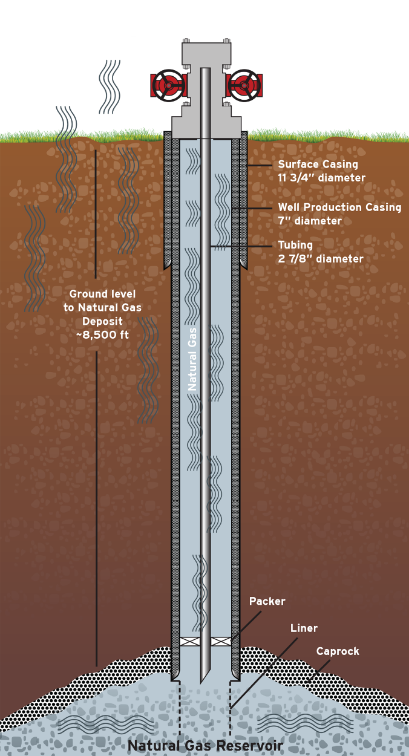
SS-25: A typical storage well, passed recent inspections
Storage wells regulated by DOGGR
Regular maintenance and inspection
  Daily observations of equipment and conditions.
  Weekly surface pressures measured and recorded.
  Monthly wellhead inspections and average pressures submitted to DOGGR.
  Annual well inspections for indications of leaks.
Steel pipe from the surface to the storage reservoir
Annual Inspections
  October 2014 – Passed most recent annual inspection.
Key Points About Leak
  Indications are natural gas is leaking from the well pipe casing into the ground near the well.
  Priority is permanently stopping the leak.
* Graphic is for informational purposes only. Scale and technical detail are not precise.

Slide 6
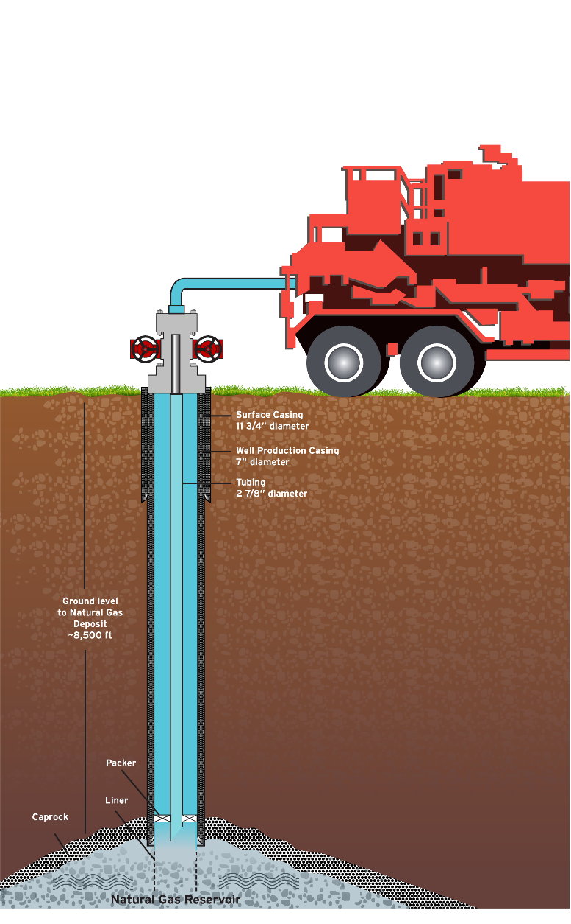
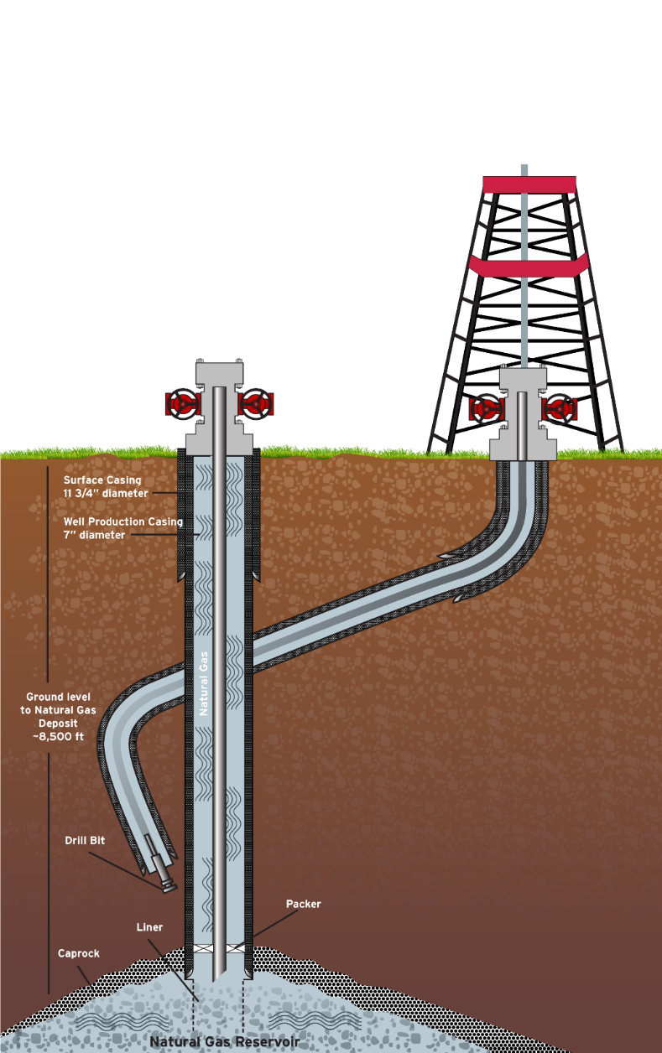
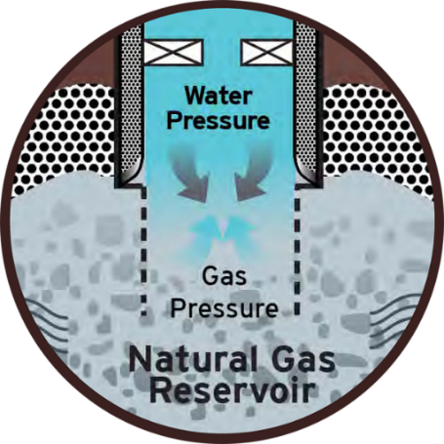
The goal is to stop the flow of gas by pumping fluids down the well, either directly down the leaking well or through a relief well.
* Graphic is for informational purposes only. Scale and technical detail are not precise. Fluids can be introduced via different methods.

Slide 7
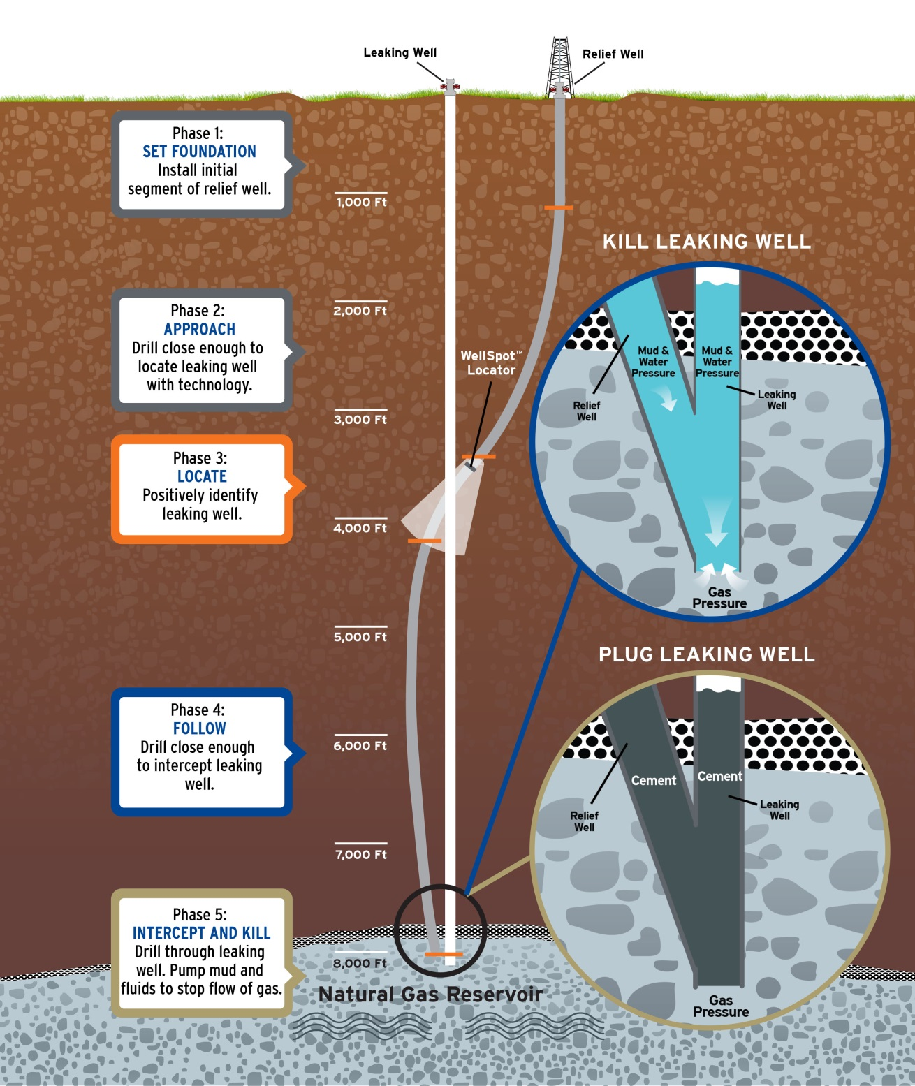
Relief Well Process
Phase 1 – Set Foundation
Install initial segment of relief well
Phase 2 – Approach
Drill close enough to locate leaking well with technology
Phase 3 – Locate
Positively identify leaking well
Phase 4 – Follow
Drill close enough to intercept leaking well
Phase 5 – Intercept and Kill
Drill through leaking well. Pump mud and fluids to stop flow of gas

Slide 8
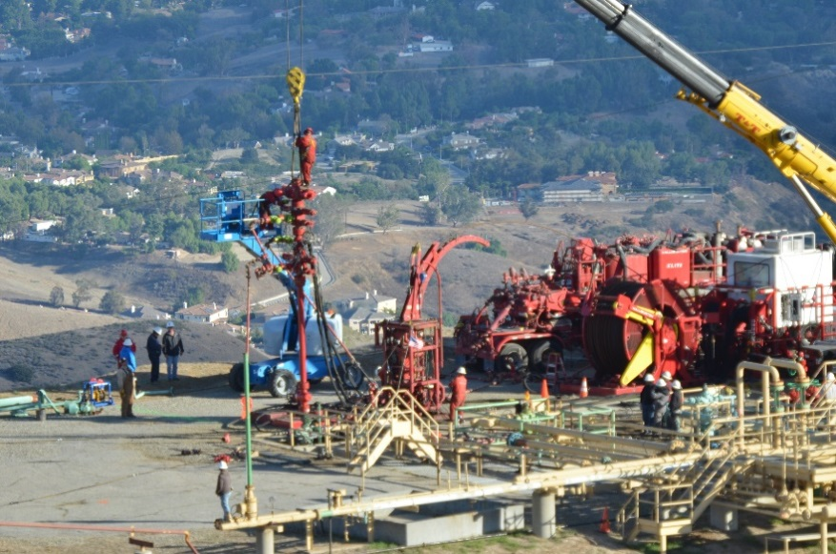
Operational Phases
October 23-25: Immediate Response and Evaluation
  Responding to leak and implementing regular procedures
October 26-29: Preparatory Period
  Taking precautions and conducting initial evaluations
October 30-November 10: Coiled Tubing Rig Operation
  Clearing blockage and evaluating conditions down entire length of well
November 11-Ongoing: Pumping Operations
  Attempting to stop the flow of gas by directly pumping fluids down well
December 4 -TBD: Relief Well Operation
  Drilling new well to intersect, and pump fluids down, leaking well

Slide 9
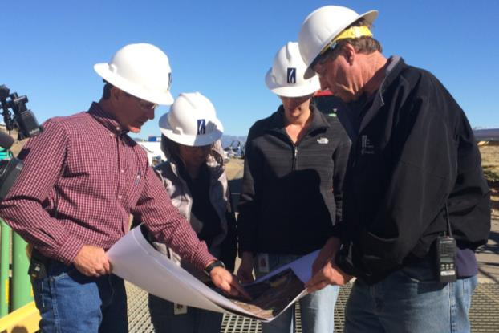
Working with world-class experts, we are following a methodical process on multiple fronts
Working as quickly as safety will allow
Relief well is the primary solution for stopping the leak
We are also working on other mitigation measures
  Reducing pressure, and thereby reducing leak flow, by withdrawing gas and sending to transmission/distribution system
  Quickly developing engineering solutions to capture leaking gas

Slide 10
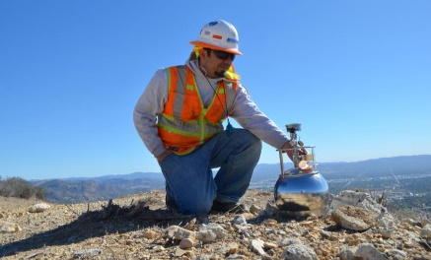
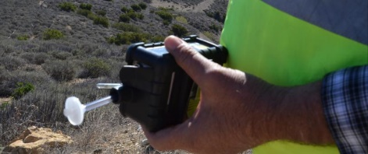
Addressing the Effects on the Community and the Environment
We are working on several fronts to address the leak’s effects,
while the work to stop the flow of gas continues
Air monitoring and sampling
Odor mitigation
Claims and relocation services
Public communication and coordination

Slide 11
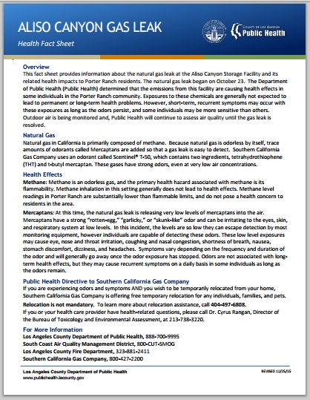
Leak poses no immediate danger or long-term health threat; however, the odor is causing symptoms and discomfort
Why it’s safe
  LA County Public Health has confirmed these levels “do not constitute an immediate danger to life, and permanent or long-term health effects are not expected.”
  LA County Health states: “short-term symptoms are expected
  to continue, as long as the odors remain”
  1+ mi. from and ~1,200 feet above the nearest home
  Natural gas is lighter than air, so it quickly rises and dissipates
  Community air sampling results have read below any level of concern
Notes:
Although it poses no immediate threat to the community, we are sorry for the leak and the affects the community is experiencing from the odor.
We are committed to stopping the leak as quickly as safety will allow.
No Immediate Danger
It is important to note:
The leak is more than a mile away and more than 1,200 feet above from the nearest home or public space
Natural gas is lighter than air, so it quickly rises and dissipates, significantly decreasing the chances for ignition and the levels of natural gas and its odorant in the community.
The odorant, which is added according to federal regulations, weakens while it is stored, so the amount of odorant leaking from the well has about one-third to one-half of what is in the gas in our homes.
No result from more than three weeks of air sampling within the community has been found above any level of concern.
County Health has confirmed these levels “do not constitute an immediate danger to life, and permanent or long-term health effects are not expected.
However, having said that, we know the unusual nature of – and uncertainty around – the leak has caused concern in the community that we want to address and that “short-term symptoms are expected to continue, as long as the odors remain.”
Stopping the leak is our priority – and before Jimmie updates you our efforts to-date – I want to talk about our efforts to address the community’s concerns.

Slide 12
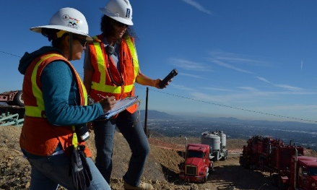
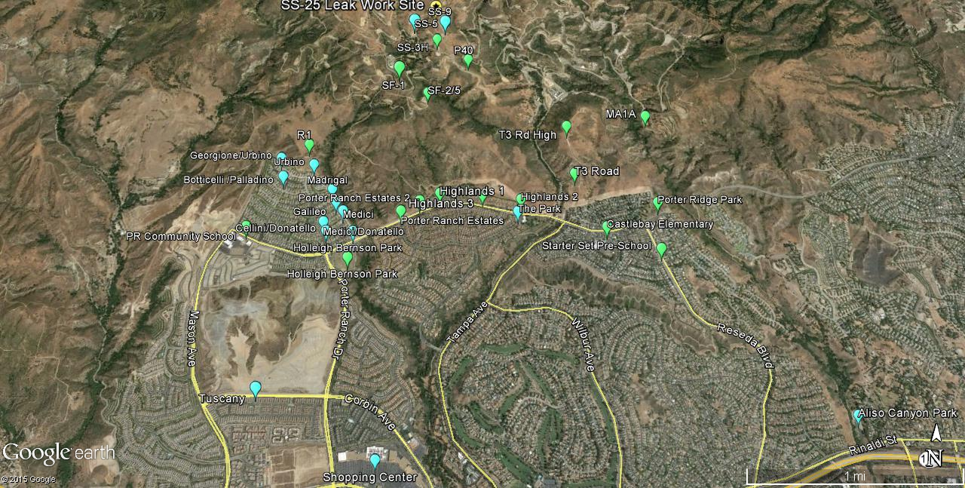
Air Sampling Collection Sites
Yellow indicates the leak site
Green indicates where samples are being consistently collected twice daily
Blue indicates where additional
samples have been collected.
Due to security policies, SoCalGas must obscure
the features of the map covering the storage facility.

Slide 13
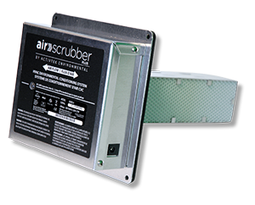

Air filtration and sealing, and temporary relocation for those affected.
SoCalGas is offering air filtration for homes and school classrooms using activated carbon filters to reduce or eliminate odors and alleviate symptoms
  77 Residences have been retrofitted with activated carbon and air scrubbers
  400 Residences have been scheduled
  Inventory arrives mid-week to meet demand
  Schools – 62 classrooms (LAUSD and preschools) have been provided with plug-in air purification
  More than 100 activated carbon filters provided to LAUSD and area preschools
SoCalGas is also providing temporary housing accommodations to alleviate symptoms some are experiencing
  3948 households requesting, 1883 placed to date
  24/7 Call Center
  Accommodation
  Meals
  Transportation – Mileage reimbursement beyond normal commuting and school transport
As much as possible, SoCalGas is accommodating alternative housing arrangements that are generally comparable to the core offer

Slide 14
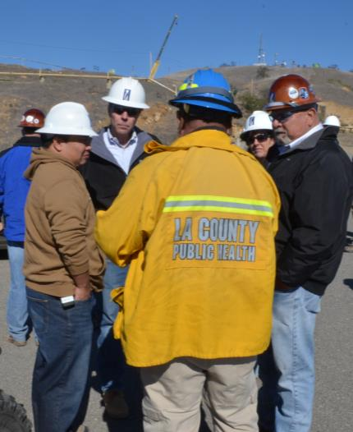
Communication / Coordination with First Responders &
Other Agencies
DOGGR, AQMD and First Responder representatives on-site
Notifications made as appropriate
Daily morning briefings with Fire, Health, AQMD and others
In-person briefings conducted periodically
Regular updates to a wide range of agency and elected officials

Slide 15
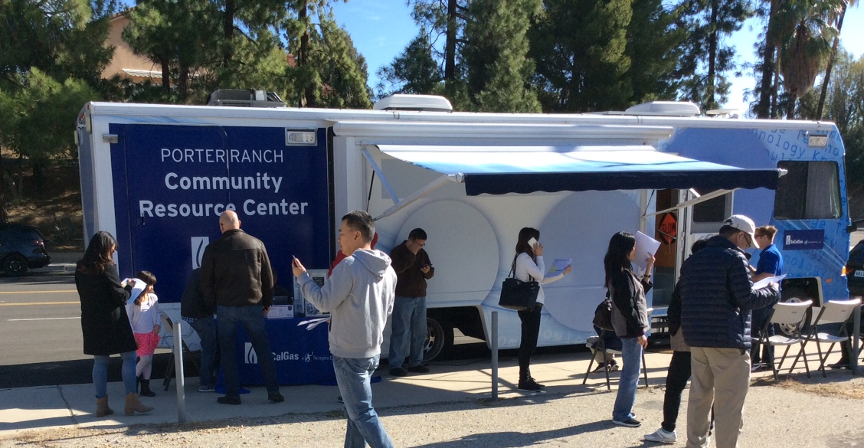
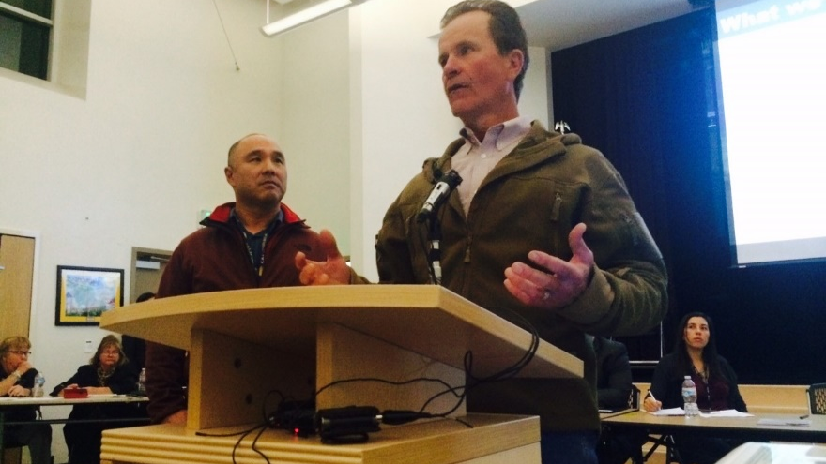
With the extended time, we are expanding our community outreach to more channels
New microsite www.AlisoUpdates.com
Weekly customer bulletins by mail and email
  Outbound calls for significant events
  Text notifications
Community Resource Center mobile version open since December 12, Porter Ranch Town Center December 16
Porter Ranch Community Advisory Committee meeting December 17

Slide 16
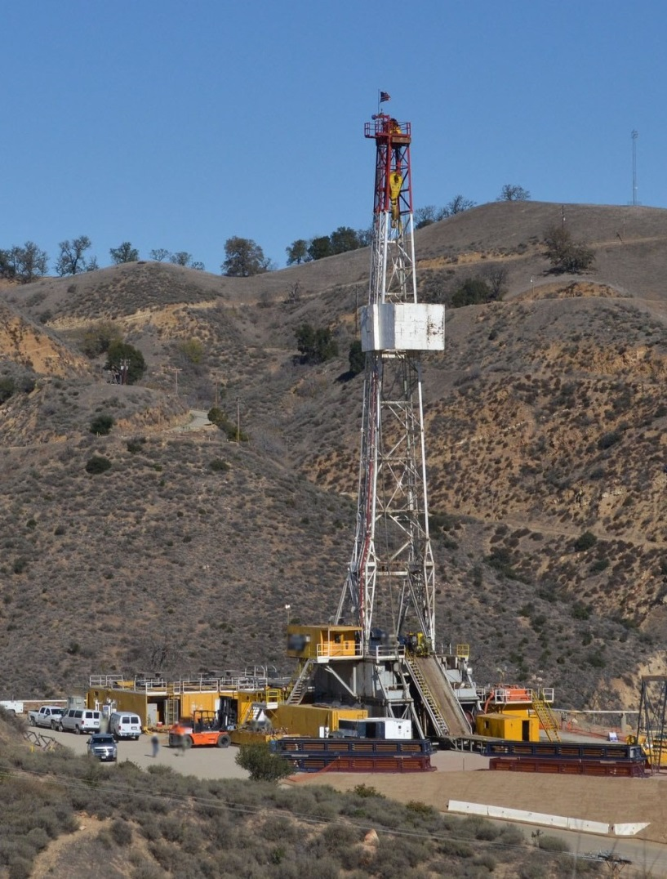
Our priority is stopping the leak; our goal is to protect the community and the environment
As an environmentally-conscious company, SoCalGas is committed to addressing the environmental impact
Determining the definitive volume released to atmosphere is only possible after reservoir pressures stabilize
SoCalGas will begin working with agency partners to understand how best to address the impact

Slide 17
Thank You

